Slide 1

“Liability Shift” Defined
By July 1, 2015
A non-compliant merchant is liable for fraud that occurs on any chip card used on a magnetic swipe terminal, with the liability for the chargeback belonging to the merchant.
A non-compliant issuer is liable for fraud that occurs on any magnetic stripe card used on a chip card-enabled terminal, with the liability for the chargeback belonging to the issuer.

Slide 2
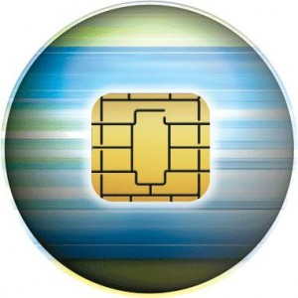
The future is now…
Chargeback liability shifts are just over two years away, now is the time to get ahead of the curve and ensure your payment hardware investment is capable of carrying you into the future.
Technology changes rapidly and Digital Wallet’s are emerging. Are you prepared to accept your customers payments?
Are you doing everything you can to protect both your customer and yourself ? Make sure your POS is capable of taking advantage of the latest security features such as EMV, card encryption & signed applications.
© 2012 VeriFone Systems, Inc.

